Slide 1

Act Locally, Impact Globally

Slide 2
Data Science Certification
Fostering Pakistan’s future through skill-based education

Slide 3

Curriculum
The focus of our Data Science Certification will be on theory as well as hands-on topics. The Curriculum is as follows:
Module 1 - Python and Data Science
Module 2 - Exploratory Data Analysis (EDA) - Getting Exploratory Insights into Databases/Lakes
Module 3 - Supervised Learning - Classifying and Predicting Business Labels
Module 4 - Unsupervised Learning - Cluster Analysis and Customer Relationship Management
Module 5 - Regression and Time Series Forecasting
Module 6 - Capstone Project

Slide 4
MODULE 2 :
EXPLORATORY DATA ANALYSIS
INSTRUCTOR : Hassan Ahmed

Slide 5
Instructor Profile – Module 2
Name: Hassan Ahmed
BE: NED UET
Professional Experience: AI Engineer at Afiniti
Email: hassanahmed8725@gmail.com
LinkedIn: https://www.linkedin.com/in/hassan-ahmed-554819148/

Slide 6
Module 2 - Exploratory Data Analysis (EDA)
Contents:
Know Your Data - Descriptive Statistics (L1)
Missing Value Analysis (L2)
Handling Data Quality Problems (L3)
Feature Selection Technique ( L4 and L5)
Data Wrangling (L6 and L7)
Performance Metrics for Machine Learning ( L8 Optional)

Slide 7
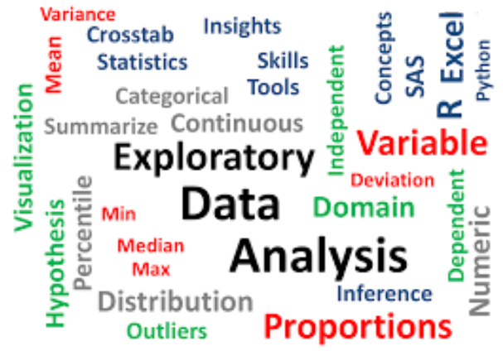
What is Exploratory Data Analysis ?

Slide 8
Exploratory Data Analysis
Definition ( Wikipedia)
In statistics, exploratory data analysis (EDA) is an approach to analyzing data sets to summarize their main characteristics, often with visual and statistical methods.
It encompasses:
Data Description
Identifying Missing & Incorrect Values
Outlier Analysis
Exploratory Data Analysis is followed by Pre-Processing

Slide 9
Data Pre-processing
Data Pre-processing is aimed at addressing the issues found in EDA Phase .
It Includes :
Handling Missing Data / Values
Handling Outliers
Feature Selection
Feature Encoding
Feature Normalization
Train-Test Split

Slide 10
Lecture 1: Exploratory Data Analysis
KNOW YOUR DATA

Slide 11
Data Description – Know Your Data
Datasets are made up of data objects.
A data object represents a data entity . For Example
In a Sales Database objects are Customers , Store Items and Sales
In a medical database , objects are patients , doctors and treatment etc.
In a university database , objects are students , courses , exams etc.
Data objects are also referred to as samples, examples, instances, data points etc.
Attributes :
An attribute is a data field representing a characteristics or feature of a data object .
Examples
Customer Name , Bill No , Item , Quantity , Bill Amount
Patient ID, Name , Treatment ID , Treatment Start Date
Arrtibue are also known as dimensions or features

Slide 12
Attribute Types
Qualitative ( Nominal , Binary , Ordinal)
Quantitative ( Interval Scaled , Ratio Scaled)

Slide 13
Attribute Types
The type of attribute is determined by the set of possible values.
There are four main attribute types:
Nominal Attributes
Binary Attributes
Ordinal Attributes
Numeric Attributes

Slide 14
Nominal Attributes
Nominal means relating to names
Also called categorical attributes
In a nominal / categorical attributes , each value represents some kind of category , code or state
The values do not have any meaningful order
Examples
Hair_color , marital_status, occupation , ID

Slide 15
Nominal Attributes
It is possible that a nominal attribute may have numeric values like codes and IDs.
For example we can use 0 for black , 1 for white , 2 for red etc
Another example is customer_ID with possible values that are all numeric
In such cases , mathematical operations on values of nominal attributes are not meaningful
Quantitate measures like mean and median are also irrelevant
Mode is the only applicable central tendency measure

Slide 16
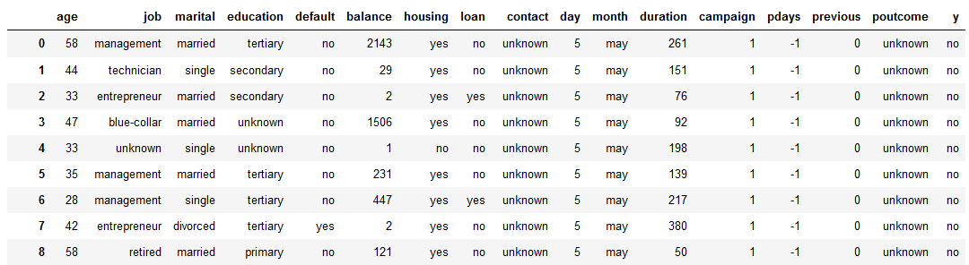
ACTIVITY : Identify Nominal Attributes

Slide 17
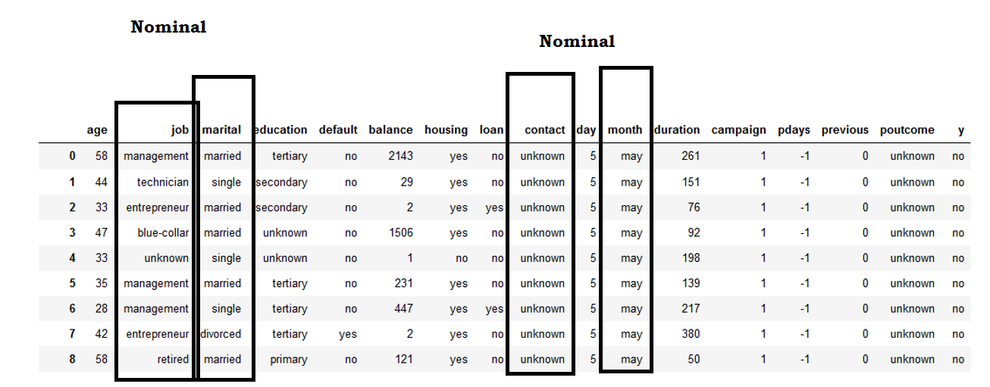
ACTIVITY : Identify Nominal Attributes

Slide 18
Binary Attributes
A Binary attribute is special type of ordinal attribute having only two possible values
Yes or No
True or False
1 or 0
If the two states correspond to True and False , then we call this Binary attribute as Boolean.
Examples :
Smoker ( Yes/ No) , Play ( Yes /No) ,Spam( Yes / No)

Slide 19
Types of Binary Attributes
There are types of Binary attributes
Symmetric Binary Attributes
Asymmetric Binary Attributes
Symmetric Binary Attributes
If both states are equally valuable
For Example Gender
Asymmetric Binary Attributes
If both states are not equally important
For Example MediacalTestOutcome
Positive Outcome and Negative outcome are not equally important
HIV Positive ( 1) and HIV Negative (0)
Convention : Important Outcome is encoded as 1

Slide 20
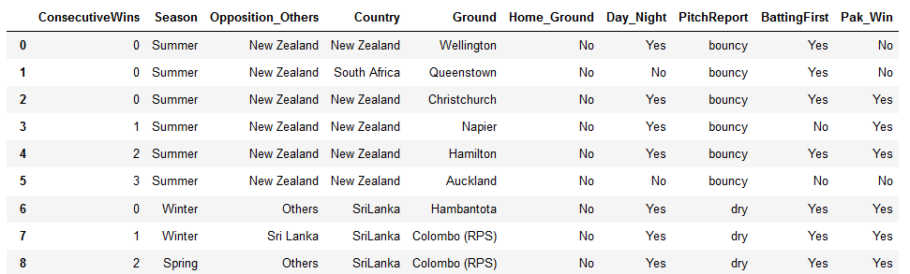
Activity : Identify Binary Attributes

Slide 21
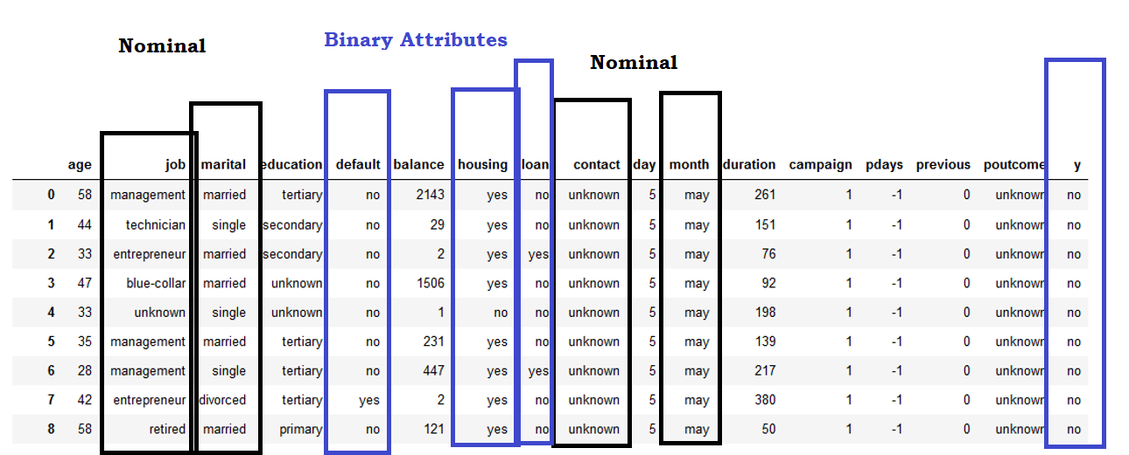
Activity : Identify Binary Attributes

Slide 22
Ordinal Attributes
Definition
An attribute with possible values having a meaningful order or ranking between them
Examples
Drink Size ( Small , Medium , Large)
Education (Primary , Secondary , Graduate , Post Graduate)
Grades ( -A , A, A+)
Response ( Dissatisfied , Neutral, Satisfied, Very Satisfied)

Slide 23
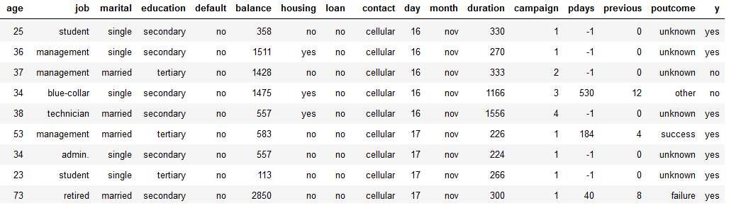
Activity : Identify Ordinal Attributes

Slide 24
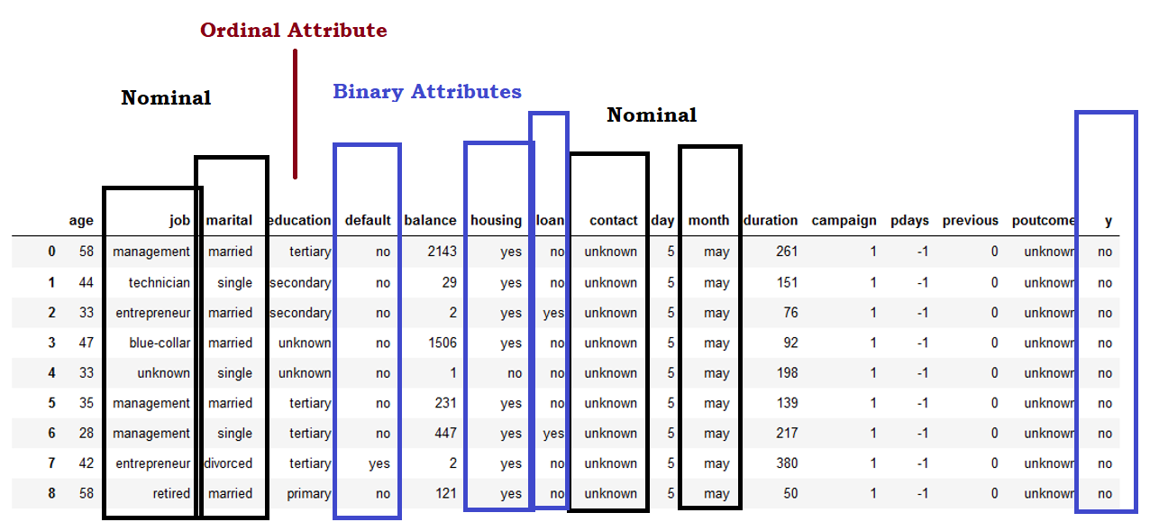
Activity : Identify Ordinal Attributes

Slide 25
Numeric Attributes
A numeric attributes is quantitative – A measurable/countable quantity
There are two sub-types
Interval Scaled ( Integers) ( countable )
Age in Years , Number of dependents
Ratio Scaled ( Float) (Measurable)
Weight , Height , Latitude , longitude

Slide 26
Discrete vs Continuous Attributes
Machine Learning Algorithms often talk about attributes as discrete and continuous
Discrete Attributes :
Having finite or Countably finite set of values
May or may not be represented as integers
Examples : IDs, Code , State , Country , Smoker ( Yes / No) , Gender
Continuous Attributes :
If an attribute is not discrete , it is continuous
Examples : Height , Weight , Temperature , length etc

Slide 27
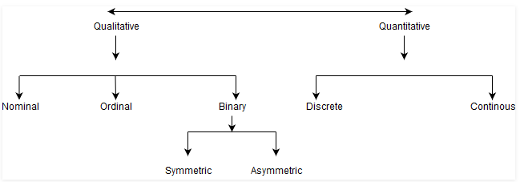
Attribute Types – Summary

Slide 28
Measure of Central Tendency
Mean , Median and Mode

Slide 29
Measure of Central Tendency
Measure of Central Tendency provides information about average or typical value of a dataset
There are three basic measures of central tendency
Mean – The Average Value
Median – The Middle Value
Mode- The most frequent value

Slide 30
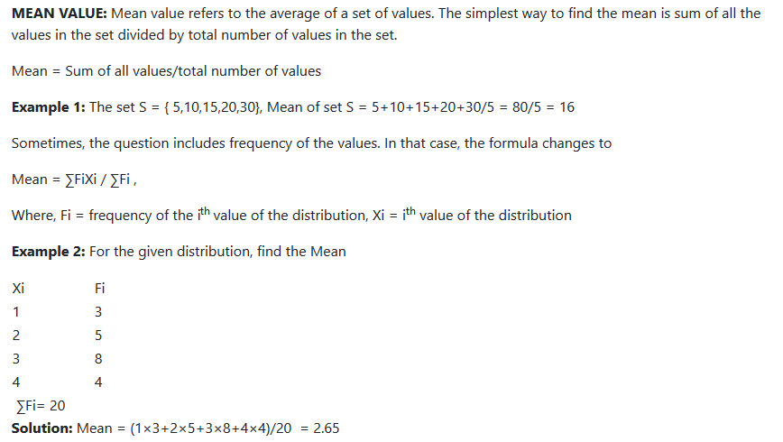
Mean

Slide 31
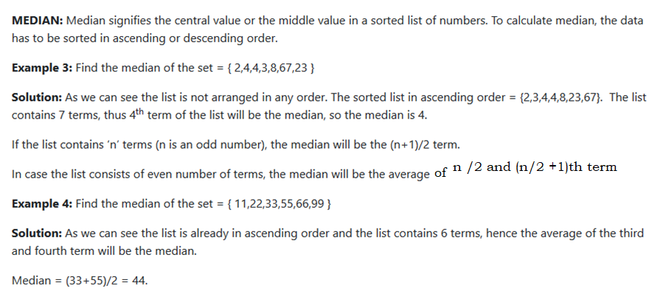
Median

Slide 32
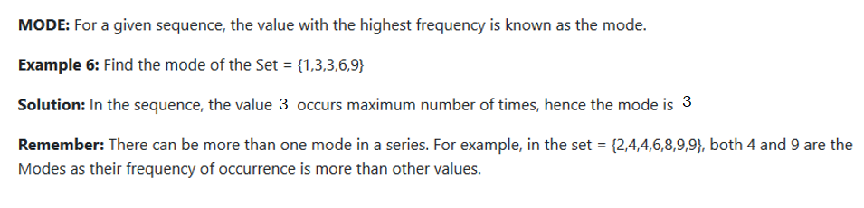
Mode

Slide 33
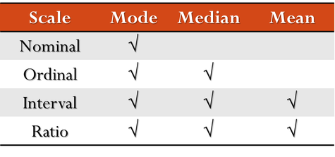
Relating MCT to Attribute Types
Mean is Sensitive to Outliers

Slide 34
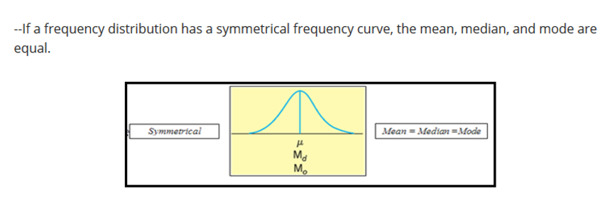
Relationship Between Mean , Median and Mode

Slide 35
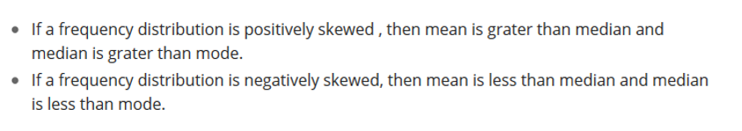
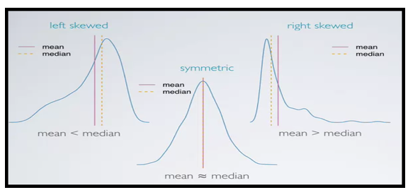
Skewness

Slide 36
Measuring Dispersion
Range , Variance , Standard Deviation & Interquartile Range

Slide 37
Measure of Dispersion
Measure of Dispersion helps in knowing the spread of data around a central measure ( for example mean )
These measure show how the distribution is spread or squeezed.
Measures of Dispersion include:
Range
Variance / Standard Deviation
Interquartile Range ( IQR)

Slide 38
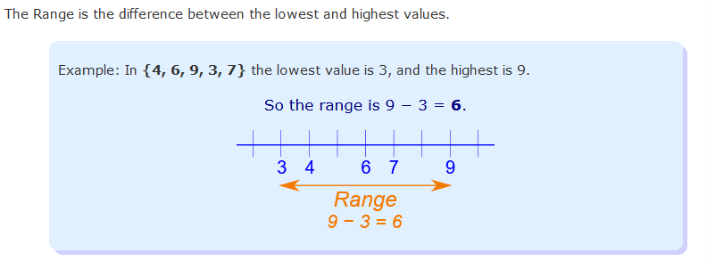
Range

Slide 39
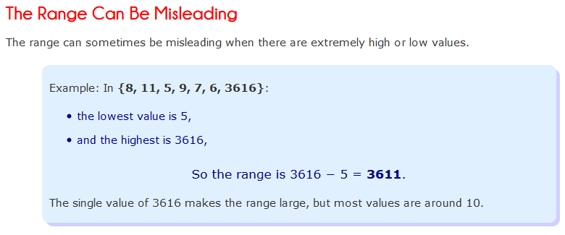
Range

Slide 40
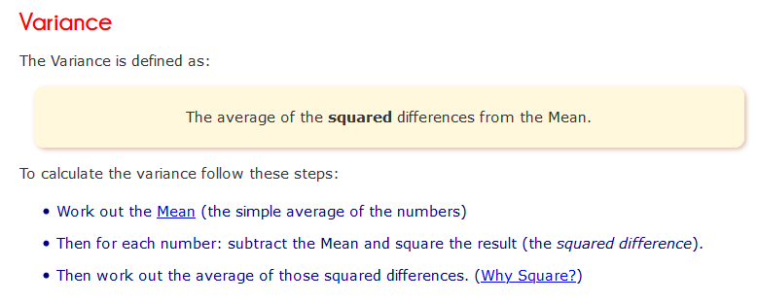
Variance

Slide 41
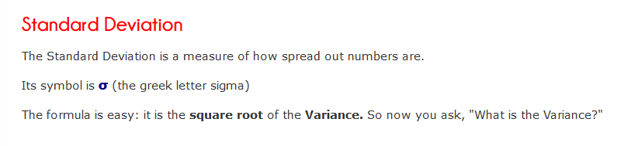
Standard Deviation

Slide 42
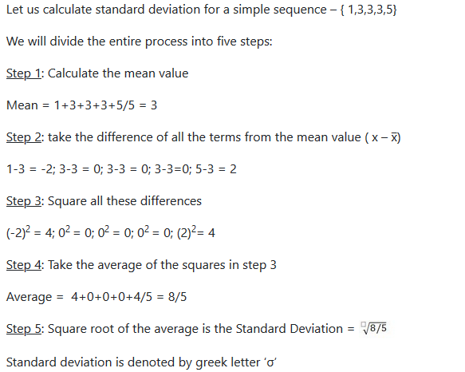
Calculating Standard Deviation

Slide 43
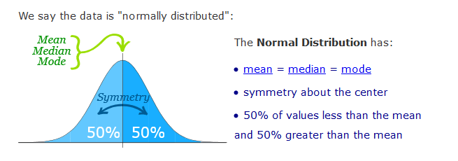
Normal Distribution

Slide 44
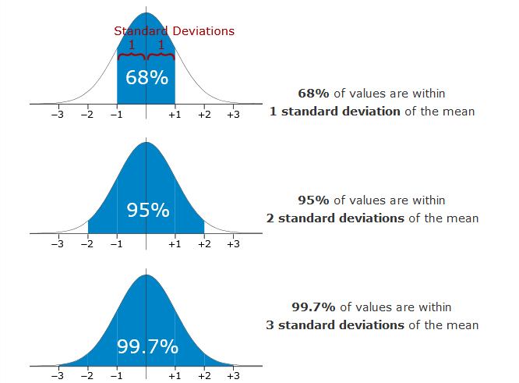
Normal Distribution

Slide 45
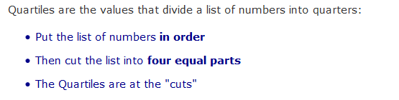
Quartiles

Slide 46
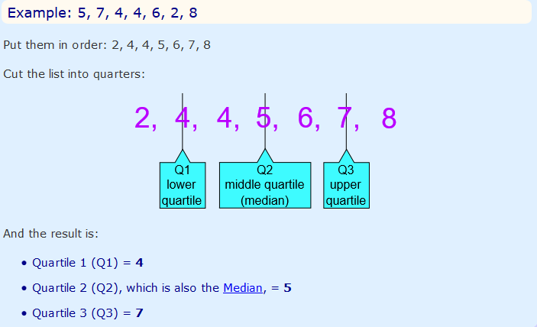
Quartiles

Slide 47
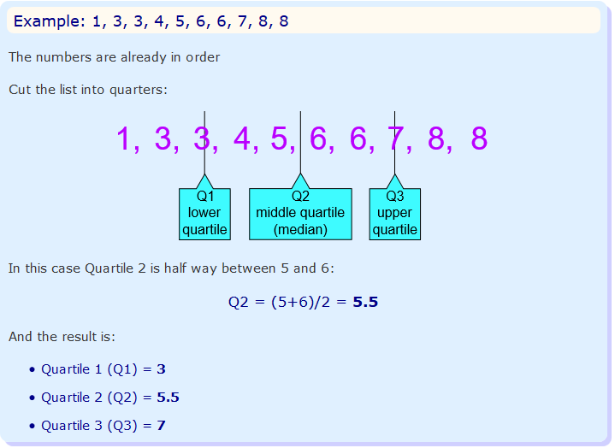
Quartiles

Slide 48
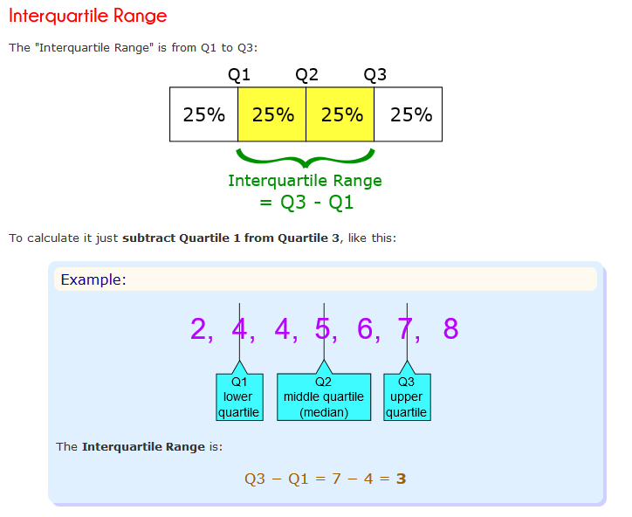
Interquartile Range

Slide 49


Box Plot – Five Number Summary
Also known as Box and Whisker Plot
It shows the blow 5 statistics
Lowest Value
Highest Value
Q1 – First Quartile ( 25 % lies below Q1)
Q2 – Median ( 50% data lies below it and 50 % data lies above it.
Q3 – Third Quartile ( 75% data lies below it and 25 % data lies above it)

Slide 50
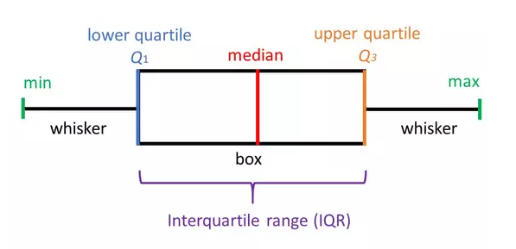
Box Plot

Slide 51

Activity : Draw the Box Plot

Slide 52
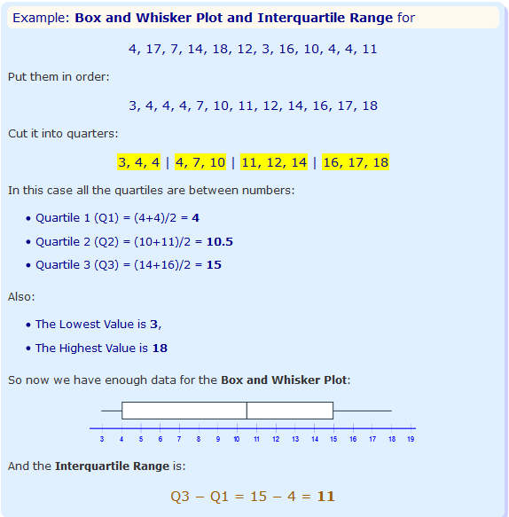
Box Plot

Slide 53
Know Your Data
Python Commands

Slide 54
Pandas Commands - Data Description
Command | Description | Syntax
shape() | Returns the number of records and dimensions in a data set | df. shape()
head() | Displays the top five rows in a dataset | df.head()
tail() | Displays the last five rows in a dataset | df.tail()
columns | Displays the column names in a dataframe | df.columns
info() | Displays general information about a dataframe including data types , number of records , number of columns with respect to data type etc. | df.info()
describe() | shows MCT and Dispersion statistics regarding numeric attributes | df.describe()

Slide 55
Hands on - Telecom Churn Dataset
KNOW YOUR DATA

